Slide 1
Google Data analytics Capstone
Case Study: How Does a Bike-Share Navigate Speedy Success?
Created by: Ahmed Marsaoui
Date: June, 2022

Slide 2
Outline
Introduction
Methodology
Defining objectives
Data sources
EDA and data manipulation
Data analysis
Data visualization
Results
Conclusion

Slide 3
Introduction
The bike share program « Cyclistic » is more and more popular
Goals differ from one user to another within Chicago city
Two main users categories with different trends:
Casual riders
Cyclistic members
The second category generates more profit thanks to their annual membership
Need of the difference study to help convert casual riders
into annual members

Slide 4
Methodology
Based onthe data analysis process: Ask, prepare, process, analyse, share and act
Each step is linked into one part from those mentioned in the introduction
The use of python for Data analyses
The use of Tableau for the Data visualization
The use of Github as the sharing medium of the obtained results

Slide 5
ASK: Defining the projects’ objectives
Analyzing the riders’ usage patterns to distinguish main differences
Document All data sources and their EDA
Results must be clearly visualized
Recommendation will be delivered to help define the membership conversion program
Key stakeholders include: Cyclistic executive team, Director of Marketing (Lily Moreno), Marketing Analytics team.

Slide 6
PREPARE: Data sources
Use of a public data source
A csv file with 13 columns and 551 480 registrations
Fields’ types are: Strings, dates and floats including the rider type (casual/ member)
Data credibility : Due to the fact that this is a case study using public data, we are going to assume the data is credible.

Slide 7
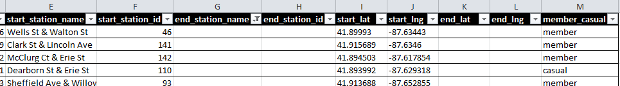
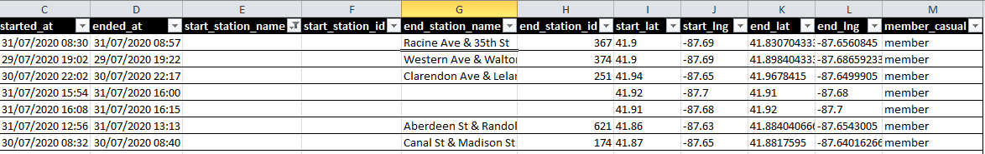
Process: EDA and data manipulations (1)
Use of:
spreadsheet for direct data exploration
Python for its advanced EDA operations
Empty cells occurs in the Start and End stations of each ride

Slide 8
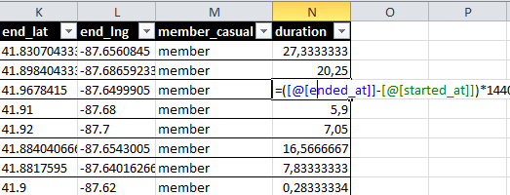
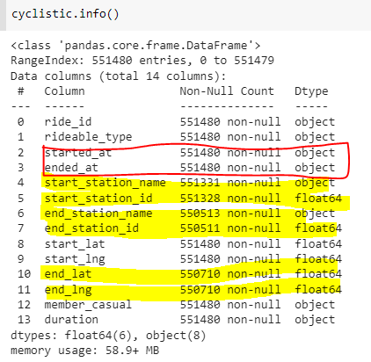
Process: EDA and data manipulations (2)
Adding a relevant columns: duration of the Trip
Getting a closer look on the
Dataframe o confirm the missing data

Slide 9
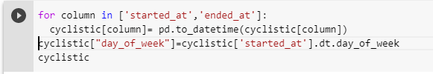
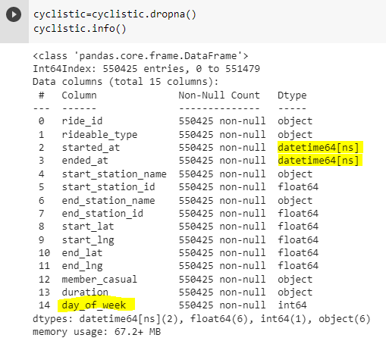
Process: EDA and data manipulations (3)
Converting the start and end dates into datetime variable
Adding a day of the week column for later user
Deleting rows with missing data (best approach since the dataset is large enough to analyze without them)
New samples: 550 425

Slide 10
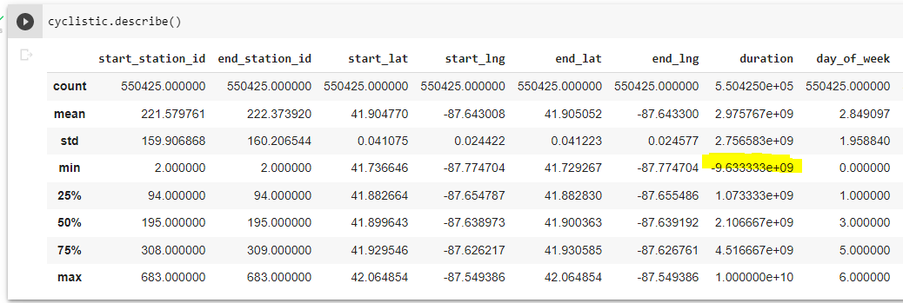
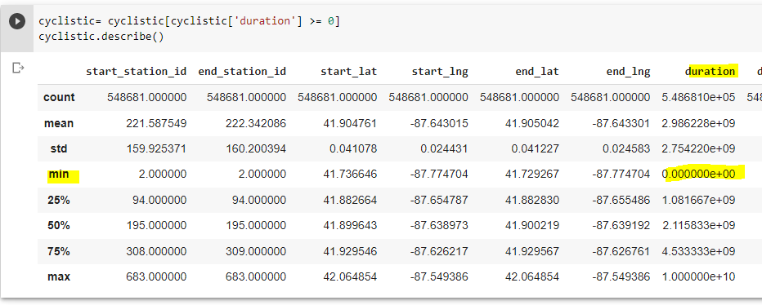
Process: Calculations (1)
Negative duration will be dropped, dataset size changed

Slide 11
Process: Calculations (2)
Measure | Code | Value

